Slide 1
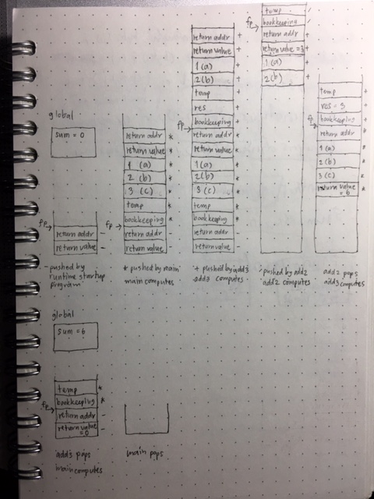
Exercise: Write sequence of stack allocation for calling add3()
int add2 (int a, int b) {
return a + b;
}
int add3 (int a, int b, int c) {
int res;
res = add2(a, b);
return res + c;
}
int sum = 0;
int main() {
sum += add3 (1, 2, 3);
return 0;
}
ด้านล่างนี่เป็น solution ที่ใช้คนละ scheme ในการสร้างสแตก ช่างมันแล้วกันนะ
Notes:
http://www-ee.eng.hawaii.edu/~tep/EE160/Book/chap14/subsection2.1.1.8.html
main() อยู่บน stack ด้วย
http://stackoverflow.com/questions/18446686/main-function-in-c
main() is the startup of the program. It must never be called from any other function.
You are not free to choose the return type of main because you did not write the code that calls main. The code calling main already existed before you even thought about learning C. It was written by the folks providing the C runtime startup code, which usually is linked automatically to your executable without you knowing. This code often resides in a file called crt0.o (created from crt0.c or even assembler in crt0.s). It expects to use a return value indicating success (0) or failure (nonzero), plus possibly other information like whether the code was terminated due to a signal and if so, which one. These are bits of Unix history.

Slide 2
return addr to add3
sum =0
a = 1
int add2 (int a, int b) {
return a + b;
}
int add3 (int a, int b, int c) {
int res;
res = add2(a, b);
return res + c;
}
int sum = 0;
int main() {
sum += add3 (1, 2, 3);
return 0;
}
b = 2
add3’s return value =0
add3’s temporaries
add3’s temporaries
res = 0
res = 0
main’s bookkeeping
main’s bookkeeping
return addr to main
return addr to main
return addr to main
a = 1
a = 1
a = 1
b = 2
b = 2
b = 2
c = 3
c = 3
c = 3
main’s return value = 0
main’s return value = 0
main’s return value = 0
Main’s pre-call and jsr
Prologue of add3
Pre-call and jsr of add3

Slide 3
int add2 (int a, int b) {
return a + b;
}
int add3 (int a, int b, int c) {
int res;
res = add2(a, b);
return res + c;
}
int sum = 0;
int main() {
sum += add3 (1, 2, 3);
return 0;
}
add2’s temporaries
add2’s temporaries
add3’s bookkeeping
add3’s bookkeeping
return addr to add3
return addr to add3
return addr to add3
a = 1
a = 1
a = 1
b = 2
b = 2
b = 2
add3’s return value =0
add3’s return value = 3
add3’s return value = 3
add3’s temporaries
add3’s temporaries
add3’s temporaries
res = 0
res = 0
res = 0
main’s bookkeeping
main’s bookkeeping
main’s bookkeeping
return addr to main
return addr to main
return addr to main
Prologue of add2
Body of add2
Epilogue of add2
3

Slide 4
sum =6
int add2 (int a, int b) {
return a + b;
}
int add3 (int a, int b, int c) {
int res;
res = add2(a, b);
return res + c;
}
int sum = 0;
int main() {
sum += add3 (1, 2, 3);
return 0;
}
add3’s temporaries
add3’s temporaries
return addr to add3
res = 3
res = 3
a = 1
main’s bookkeeping
main’s bookkeeping
b = 2
return addr to main
return addr to main
return addr to main
add3’s return value = 3
a = 1
a = 1
a = 1
add3’s temporaries
b = 2
b = 2
b = 2
res = 3
c = 3
c = 3
c = 3
main’s bookkeeping
main’s return value = 6
main’s return value = 6
main’s return value = 6
return addr to main
Post-call of add3
add3’s body
add3’s Epilogue
Body of main and post-call

Slide 5
Exercise: Heap-Based Objects and Binding
Since lifetime means the time between creation and destruction,
Binding lifetime is time between creation and destruction of a name-to-object binding.
Object lifetime is time between creation and destruction of an object.
If object lifetime is longer than binding lifetime, we have memory leak (or garbage).
If binding lifetime is longer than object lifetime, we have dangling reference.
Notes:
Binding lifetime is time between creation and destruction of a name-to-object binding.
Object lifetime is time between creation and destruction of an object.
If object lifetime is longer than binding lifetime, it is memory leak (or garbage).
If binding lifetime is longer than object lifetime, it is dangling reference.

Slide 6
Exercise: Scope and Referencing Environment
op1 is considered one scope and op2 another scope.
Scope of x and y is op1.
Scope of z is op1 (first z) and op2 (second z). There are two bindings of z.
Referencing environment of op1 consists of x, y, (first) z, op1, op2.
Referencing environment of op2 consists of (second) z, op2, op1.
//C float op1(int x, float y) { int z; … } float op2(int z) { … }
Notes:
Scope of x and y is op1.
Scope of z is op1 (first z) and op2 (second z). There are two bindings of z.
Referencing environment of op1 consists of x, y, (first) z, op1, op2.
Referencing environment of op2 consists of (second) z, op2, op1.
op1 is considered as one scope and op2 another scope.

Slide 7
Exercise: Static Link in Nested Subroutines
temp
P3
local var
bookkeeping
return addr
return addr
3 (A3)
3 (A3)
temp
temp
P2
local var
P2
local var
bookkeeping
bookkeeping
return addr
return addr
return addr
2 (A2)
2 (A2)
2 (A2)
P4
temp
temp
temp
local var
P4
local var
P4
local var
bookkeeping
bookkeeping
bookkeeping
return addr
return addr
return addr
return addr
4 (A4)
4 (A4)
4 (A4)
4 (A4)
temp
temp
temp
temp
X:real
X:real
X:real
X:real = 3
P1
bookkeeping
P1
P1
P1
bookkeeping
bookkeeping
bookkeeping
return addr
return addr
return addr
return addr
1 (A1)
1 (A1)
1 (A1)
1 (A1)

Slide 8
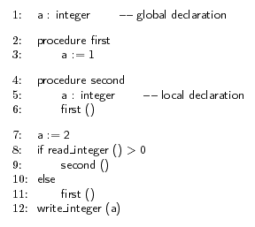
Exercise: Bindings in Dynamic Scoping
With dynamic scope rule, if first is entered from main
What does write_integer refer to, global a or local a? Global a
What does write_integer write? Global a = 1
temp
first
bookkeeping
return addr
global a = 2 1

